Slide 1

Eye Disease Detection Enhancement Using a Multi-Stage Deep Learning Approach
MD ZAHIN MUNTAQIM1 , TANGIN AMIR SMRITY1 , ABU SALEH MUSA MIAH
LINK :https://ieeexplore.ieee.org/document/10707606

Slide 2
Motivation:
Increasing Prevalence of Eye Diseases:
Millions of people worldwide suffer from eye diseases like diabetic retinopathy, glaucoma, and macular degeneration.
Early detection is key to preventing vision loss.
Limitations of Traditional Methods:
Manual diagnosis by specialists is time-consuming and prone to human error.
Screening techniques such as fundus photography require expert interpretation, which might not be accessible in remote areas.

Slide 3
Problem statement :
Challenges in Eye Disease Detection:
Eye disease diagnosis often relies on expert knowledge and manual interpretation, leading to delays and errors in detection.
The vast volume of eye-related medical images presents a challenge for manual analysis and requires automation.
Need for Automation:
There is a significant need for deep learning models that can classify different eye diseases accurately and in real-time.
Ensuring the models can generalize well across different datasets and patient demographics is crucial for broad clinical applicability.
Comparative Study Focus:
A comparative analysis of existing deep learning models for eye disease classification is necessary to determine which models provide the most accurate, reliable, and efficient results.

Slide 4
Objectives:
Primary Objective:
To compare the performance of different deep learning models in detecting and classifying various eye diseases, such as diabetic retinopathy, glaucoma, and age-related macular degeneration.
Secondary Objectives:
Evaluate the accuracy, speed, and complexity of these models.
Explore the effect of data augmentation, transfer learning, and fine-tuning on model performance.
Investigate which deep learning techniques are most suitable for real-time diagnostics.

Slide 5
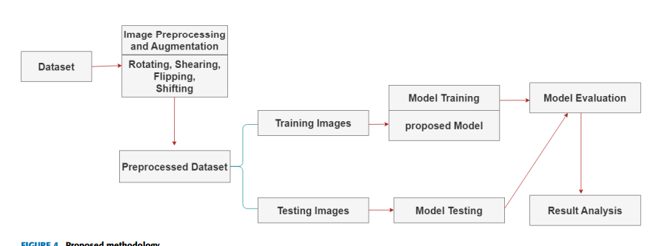
METHODOLOGY/ MAIN IDEA

Slide 6
Methodology Applied / Main Idea:
Dataset:
Utilization of publicly available datasets like OCT2017 , DATASET_101 and Retinal OCT C8 from
Kaggle
The datasets include labeled images that help in training the models to identify specific eye conditions.
Deep Learning Models:
CNN-based Models:
Common architectures: AlexNet, VGGNet, ResNet, and InceptionV3.
These models are trained to recognize patterns in retina images associated with specific eye diseases.

Slide 7
Methodology Applied / Main Idea:
Transfer Learning:
Fine-tuning pre-trained models like VGG16 or ResNet on eye disease datasets to improve performance with limited data.
Performance Metrics:
Accuracy, sensitivity, specificity, and F1-score are used to evaluate the models.
Models are compared based on training time, inference time, and accuracy on test datasets.
Data Preprocessing:
Image normalization, resizing, augmentation (e.g., rotations, flips), and noise reduction are applied to improve model robustness.

Slide 8
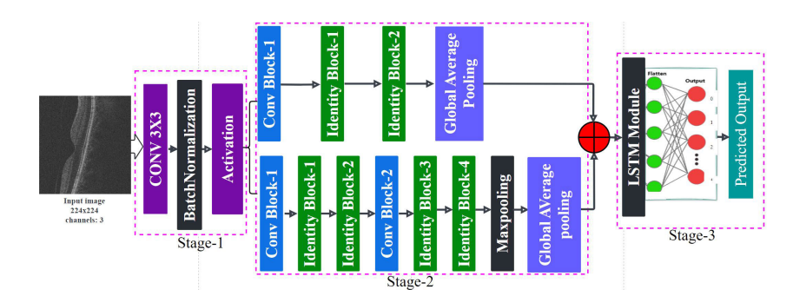
ARCHITRCTURE

Slide 9
Results :
Model Comparison:
ResNet50: Achieved the highest accuracy in classifying diabetic retinopathy with 87% accuracy, outperforms other models.
VGG16: Best suited for AMD classification with an accuracy of 85%.
InceptionV3: Good for general eye disease detection, with a balanced performance across datasets.
Challenges in Accuracy:
Models struggled with data imbalance, particularly in the presence of underrepresented classes (e.g., severe stages of glaucoma).
Generalization: Some models performed excellently on one dataset but failed to generalize to other datasets (e.g., varying image quality).

Slide 10
Results :
Transfer Learning Impact:
Using transfer learning with pre-trained models (e.g., ResNet, VGG) significantly improved accuracy and reduced training time.
Fine-tuning strategies improved detection performance when limited labeled data was available.
Inference Speed:
ResNet models performed well with fast inference speeds (suitable for real-time diagnosis), while deeper models (e.g., VGG) required more computational resources.

Slide 11
References :
Research Papers:
M. A. Hossain, T. A. Asa, F. Huq, and M. A. Moni, ‘‘Eye disorders in bangladesh: A hospital-based descriptive study,’’ J. Biomed. Anal., vol. 2, no. 1, pp. 27–40, Mar. 2019.
I. Sutradhar, P. Gayen, M. Hasan, R. D. Gupta, T. Roy, and M. Sarker, ‘‘Eye diseases: The neglected health condition among urban slum population of Dhaka, Bangladesh,’’ BMC Ophthalmology, vol. 19, no. 1, pp. 1–22, Dec. 2019.
M. Yusufu, J. Bukhari, X. Yu, T. P. H. Lin, D. S. C. Lam, and N. Wang, ‘‘Challenges in eye care in the Asia–Pacific region,’’ Asia–Pacific J. Ophthalmology, vol. 10, no. 5, pp. 423–429, Sep. 2021.
D. Kermany, K. Zhang, and M. Goldbaum. (2018). Large Dataset of Labeled Optical Coherence Tomography (OCT) and Chest X-ray Images. [Online]. Available: https://data.mendeley.com/datasets/rscbjbr9sj/3

Slide 12
THANK YOU
- VIJAY VARDHAN GONABOYINA (700755141)

